Slide 1
Budget Construction Overview
University Budget Office
Office of the Executive Vice President for Finance & Administration

Slide 2

Budget Development
The University Budget Office (UBO) develops and manages the state operating appropriation request as well as the official budget, including fee rate setting and budget construction. Budget construction is an annual process in which UBO assists the campuses in setting their financial plans and priorities as part of their formal budget submission.
The campuses use budget construction to formalize their financial plans and priorities as well as establish and as needed, refresh their strategy for resource management for the upcoming fiscal year. While UBO provides tools and policies such as salary guidelines, budget allocation decision-making occurs at the campus-level.
Together, the campuses and UBO rely on budget development as a tool to establish a budgetary framework for planned activities and to help ensure financial decision-making reflects the objectives of the campuses and the IU system.

Slide 3
UBO’s Role
Official Budget Request
On a biennial basis, UBO manages fee rate setting by reviewing any changes in fee rates submitted by campuses for the new biennium and ensuring approval prior to implementation.
The campuses’ budget submissions are compiled and consolidated by UBO to create a formal budget request.
UBO presents the official budget request to the Board of Trustees for review and approval.
State Operating Appropriation Request
On a biennial basis, UBO with assistance from Capital Planning and Facilities and Institutional Analytics and in coordination with state agencies including IFA and CHE, develops the biennial request for state operating appropriations and capital.
Budget Calendar
UBO releases a budget construction processing schedule to establish key dates and deliverables.
Policies & Guidelines
Throughout the budget development process, UBO shares policies, guidelines, and data with the campuses to assist in budgeting for variables. This includes but is not limited to salary policies, benefit rates, UA targets, and energy and utilities actuals. In addition, campuses are provided an amount for the UA assessment for the upcoming year. This represents a portion of the campus assessment for units.
Systems & Support
UBO hosts a variety of portals that support the campuses in budget development preparation and are intended to be used as tools to assist in the projection of revenue and expenditures, submission of fee rates requests and fee rate changes, and future year modeling.

Slide 4
Campus Role
Budget Preparation & Construction
During the onset of budget construction, unit fiscal officers and campus fiscal leadership utilize UBO-hosted budgeting tools to set base revenue and expenditure projections.
Budget construction is a collaborative effort between campuses and their units. Fiscal officers within each unit determine how best to allocate their budget and input those decisions into the budget construction module. Units maintain discretion in how they budget their funding, but all budgets are subject to review by campus fiscal and executive leadership to ensure adherence to University policies and alignment with the goals of the campus.
Budget Construction Communications & Guidance
Separate from the documentation and guidance UBO shares with campuses, campus financial and administrative leadership distributes detailed budget construction materials such as campus-specific budget calendars, budget construction guidelines, and training courses to their units.
As UBO shares policies, guidelines, and data with the campuses throughout the budget construction process, campuses’ financial leadership disseminates the information and directions to units.
Executive and financial leadership consult with various campus committees, councils, and resource planning groups to ensure unit and campus-level stakeholders are engaged.

Slide 5
Campus Deliverables
Throughout the budget construction process campuses submit a variety of deliverables including base budget data, projections, and fee requests which serve as the basis of their budget request. This detailed approach to budget construction is a joint effort between campuses and their units, allowing for budget requests to incorporate both unit specific objectives and campus-level priorities.
.
1
Base Transfers, Reorganizations, & Reallocations
4
Credit Hour Revenue Projections
2
Incidental Income
5
Tuition Revenue Projections
3
New Fees & Fee Rate Increase Requests
6
Budget Narratives

Slide 6
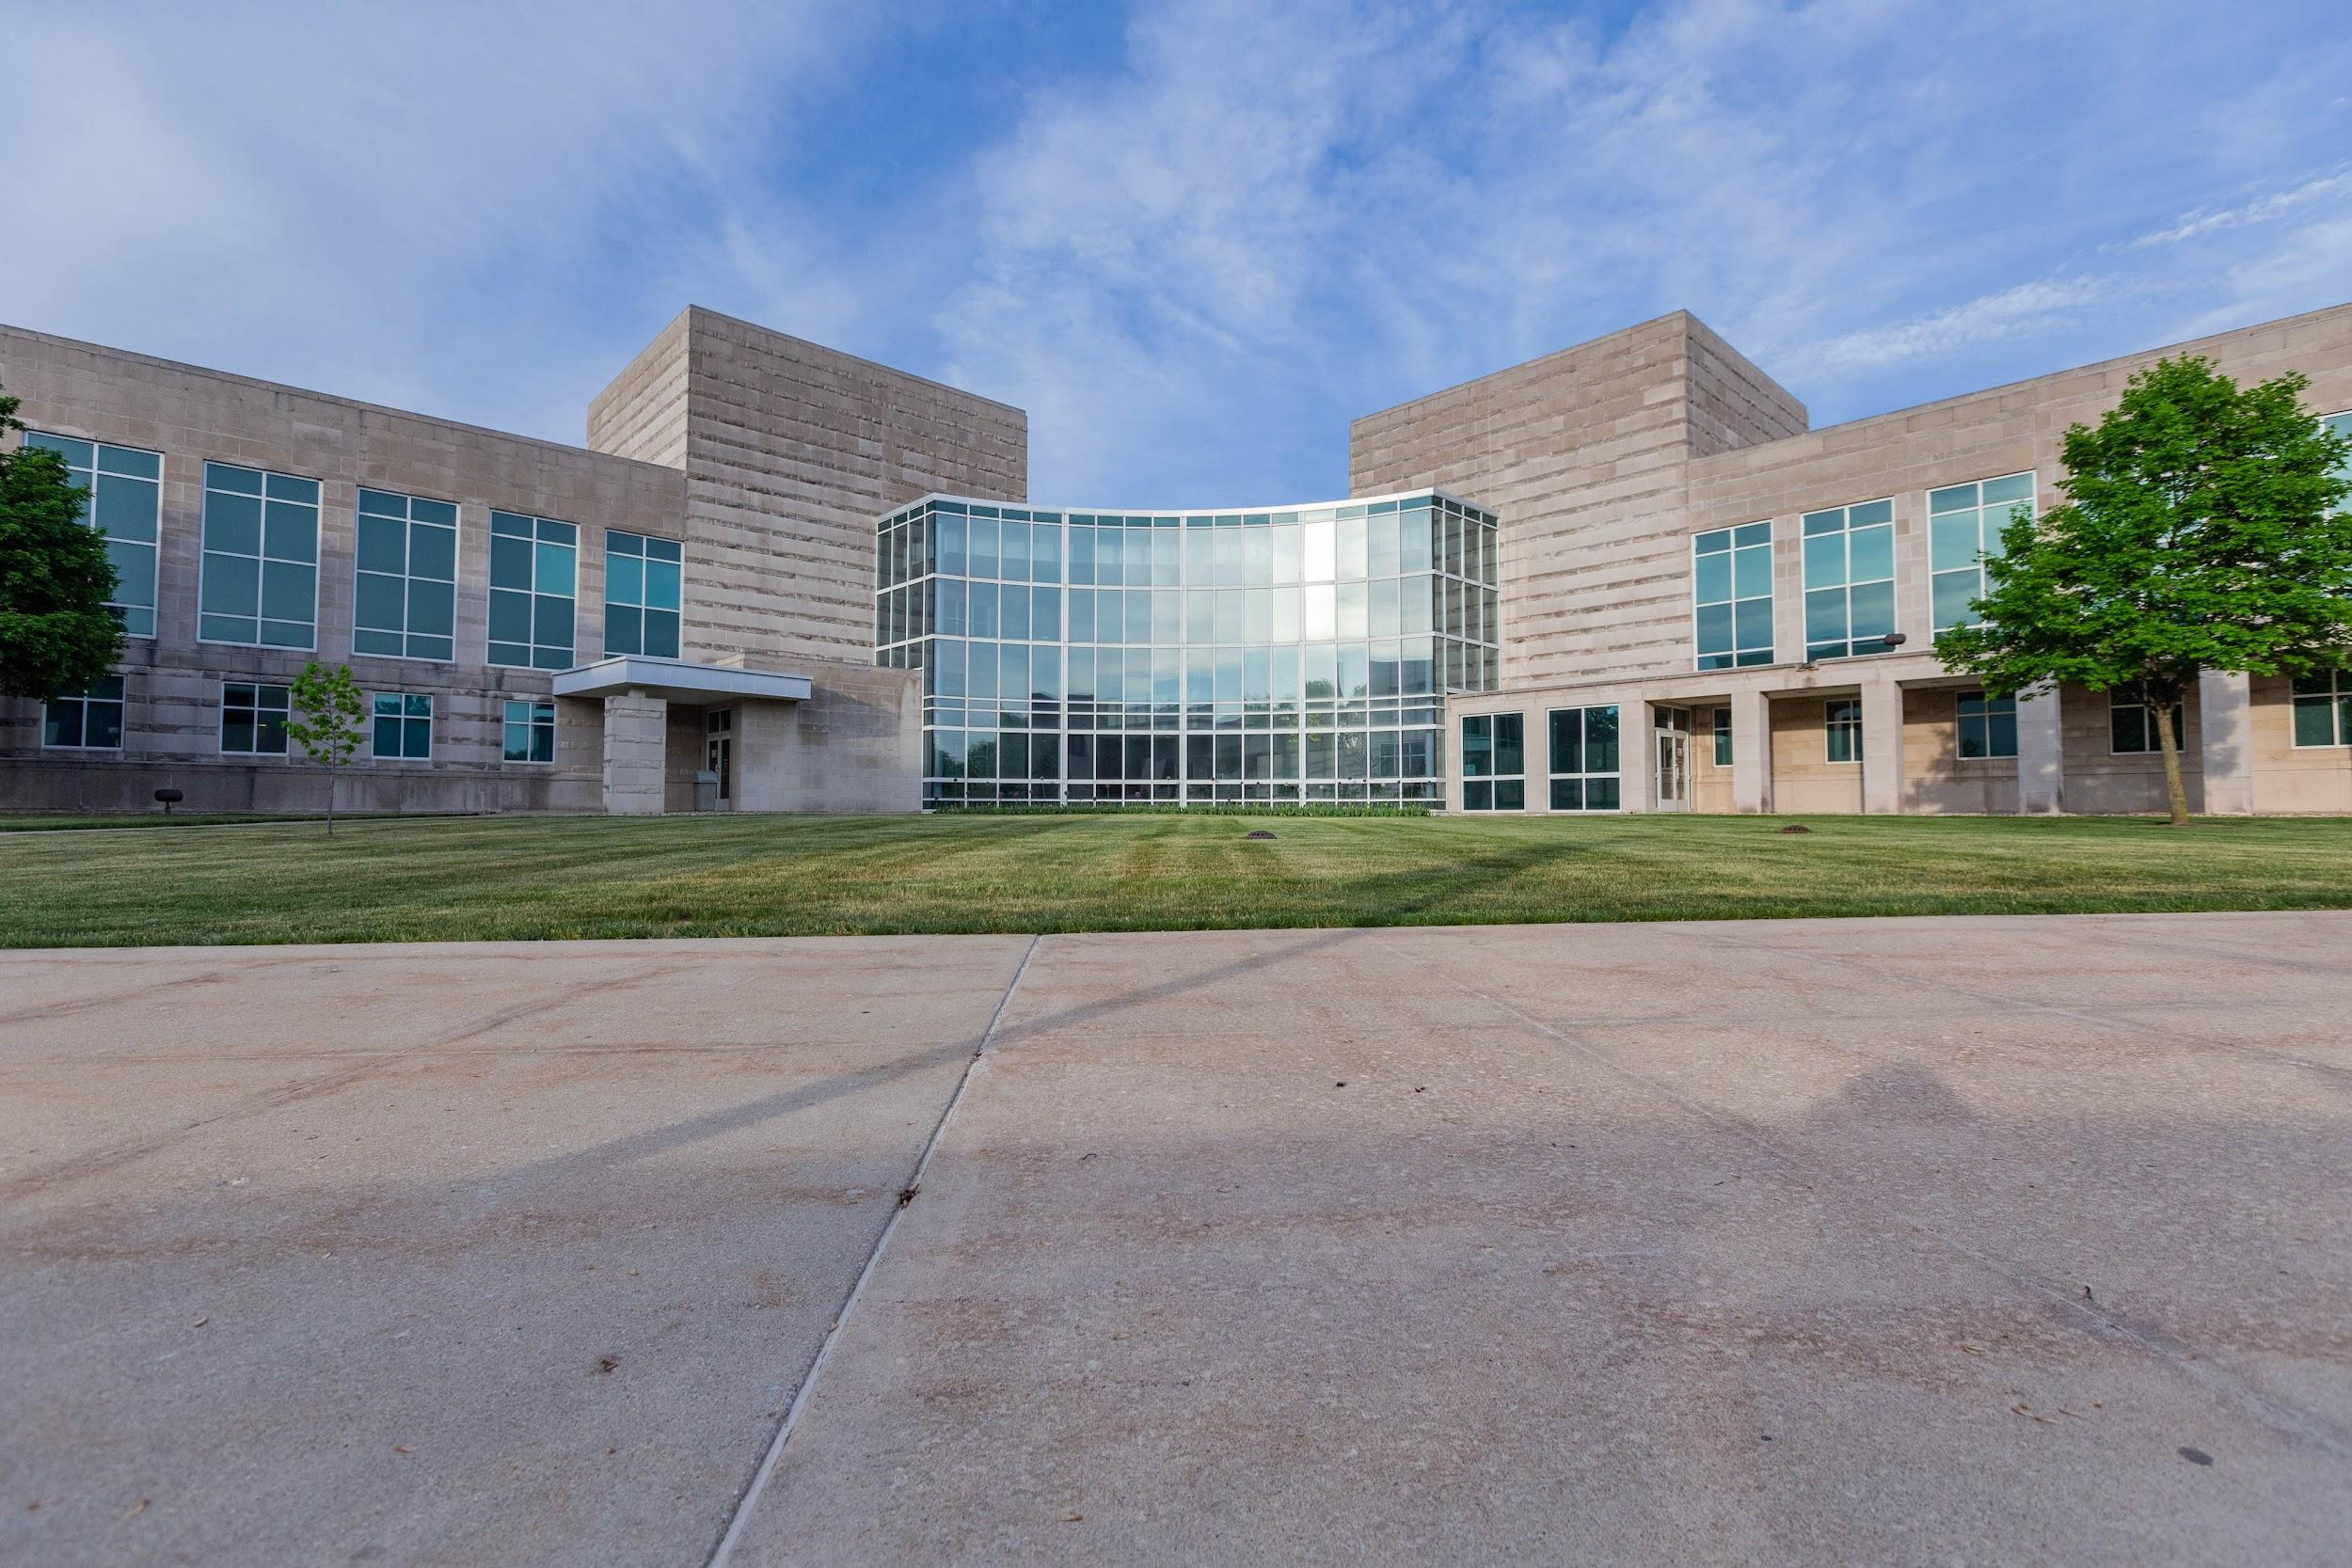
*Non-Budget Session Year
* Occurs Annually
FY26 Budget Construction Timeline
Budget Development Kick-Off
Budget Resources Sent To Campuses
Budget Construction
A budget calendar is shared with the campuses to identify key dates and deliverables. Additionally, UBO-hosted budget development systems begin to open for use by the campuses for financial planning and projections.
UBO shares resources with the campuses for planning purposes including but not limited to budget instructions, the draft salary policy for the new fiscal year, and benefit rates.
March through April, campuses enter their formal budget submission in the budget construction environment. Budget requests are prepared at the unit-level, reviewed at the campus-level, then consolidated by UBO.
November 2024
February 2025
June 2025
October 2024
February 2025
March-April 2025
Budget Presentations & Approval of Budget
Campus Budget Planning
President’s Budget Conferences
In November campuses begin to utilize various UBO budget development tools for projections and modeling. Concurrently, the campuses share an internal budget calendar and guidelines with units to assist in unit-level budget development.
Campuses meet with President to provide an overview of their budget and commitment request(s).
In June, the formal budget request is presented to the Board of Trustees for review and approval. Following, the official budget is circulated.

Slide 7
*Budget Session Year
*Occurs Biennially (odd-numbered years)
*Timeline runs concurrently with non-budget session year dates & activities
FY26-27 Budget Construction Timeline
Operating Appropriation(s) and Capital Request Development
Budget Committee Presentation
Legislative Session End
Budget Presentations & Approval of Budget
The Commission on Higher Education (CHE) presents their recommendations on the state educational institutions’ budget requests to the State Budget Committee prior to the start of legislative session. IU subsequently presents an overview of the University’s state operating appropriation and capital request.
Final University state operating appropriation and capital requests are formally approved in April with the passing of the state budget bill, House Enrolled Act-1001.
Tuition and mandatory fees are presented to the Board of Trustees for approval along with the final budget request.
UBO begins the construction of the state operating appropriation and capital request. The request consists of performance funding data, special line items, and capital projects.
September 2024
January-March 2025
May-June 2025
April-August 2024
November 2024
April 2025
June 2025
Presentation to Board of Trustees
State Budget Presentations
Tuition & Fee Rates Setting
UBO in coordination with Capital Planning and Faculties presents the University state operating appropriation and capital request along with the ten-year capital project plan.
During legislative session, IU presents the state operating appropriation and capital budget request to the House Ways & Means Committee and the Senate Appropriation Committee. The bill that contains IU’s appropriation requests passes through these committees.
No later than 30 days after the enactment of the state budget, CHE shall recommend nonbinding tuition and mandatory fee increase targets for each state educational institution. Within 30 days of CHE’s recommendation on tuition and mandatory fees, IU must hold a public hearing regarding tuition and fee rate increases. Tuition and mandatory fees must be set by the campuses and Board of Trustees within the 60 days after the enactment of the state budget.

Slide 8
Addendum: Budget Implementation
Similar to the budget development process, budget implementation includes numerous points of collaboration with varying responsibilities between UBO and the campuses.
Budget Application
Budget Adjustments
Budget Review & Monitoring
Once the official budget is approved, the campuses begin to execute their planned spending, collection of revenues, and execution of priorities and projects. Each unit within a given campus is responsible in how they allocate funds.
Although the campuses are exhaustive in budgeting for all known and projected variables impacting their budget, adjustments are necessary to ensure that spending does not exceed the resources of the campus as unforeseen variables emerge. The campuses maintain the discretion to make adjustments within their budget so long that proper documentation is completed and approval processes are fulfilled in instances that it is required.
Per existing University policy, UBO reviews permanent reallocations and changes in organizations. Additionally, UBO assists with data reporting and analysis in order to monitor the financial health of university and support ongoing financial planning efforts.

Slide 9
Resources
01 | Budget Calendars https://www.budu.iu.edu/documentation/calendar/archives
02 | Budget Guidelines & Instructions https://www.budu.iu.edu/documentation/guidelines
03 | Official Budgets https://www.budu.iu.edu/reports/officialbudgets
04 | Approved Fee Rates https://www.budu.iu.edu/reports/feerates
05 | RC Operating Budget https://www.budu.iu.edu/reports/rcbudgets

Slide 10
Contact Us
Questions?
Megan Ornellas, Associate Vice President for Budget and Planning
budu@iu.edu

